Slide 1
Optimal control strategies to prevent the hospital beds collapse during Covid-19 outbreak

Slide 2
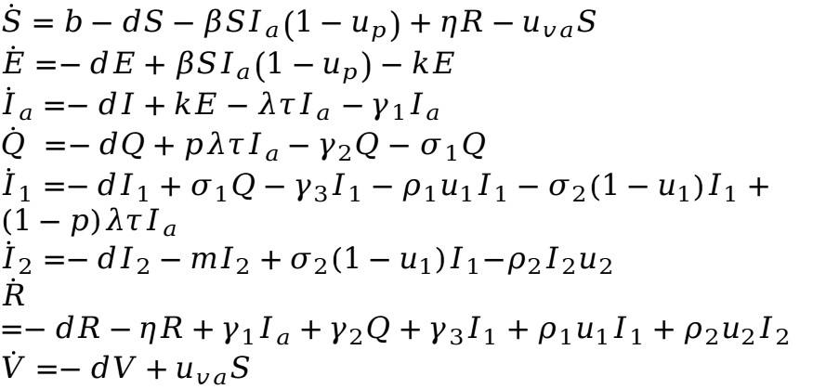
Mathematic model: state equations with control
$$\dot{S}=b−dS−βSI_{a}\left(1−u_{p}\right)+ηR−u_{va}S$$
$$\dot{E}=−dE+βSI_{a}\left(1−u_{p}\right)−kE$$
${\dot{I}}_{a}=−dI+kE−λτI_{a}$ $−γ_{1}I_{a}$
$\dot{Q} =−dQ+pλτI_{a}−γ_{2}Q−$ $σ_{1}Q$
${\dot{I}}_{1}=−dI_{1}+σ_{1}Q−γ_{3}I_{1}−ρ_{1}u_{1}I_{1}−σ_{2}\left(1−u_{1}\right)I_{1}+(1−p)λτI_{a}$
$${\dot{I}}_{2}=−dI_{2}−mI_{2}+σ_{2}(1−u_{1})I_{1}{−ρ}_{2}I_{2}u_{2}$$
$$\dot{R}=−dR−ηR+γ_{1}I_{a}+γ_{2}Q+γ_{3}I_{1}+ρ_{1}u_{1}I_{1}+ρ_{2}u_{2}I_{2}$$
$$\dot{V}=−dV+u_{va}S$$

Slide 3
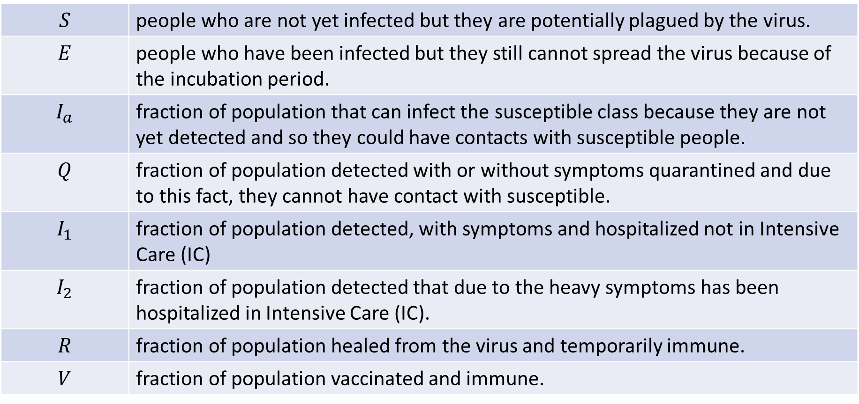
Compartments definition
$$S$$ | people who are not yet infected but they are potentially plagued by the virus.
$$E$$ | people who have been infected but they still cannot spread the virus because of the incubation period.
$$I_{a}$$ | fraction of population that can infect the susceptible class because they are not yet detected and so they could have contacts with susceptible people.
$$Q$$ | fraction of population detected with or without symptoms quarantined and due to this fact, they cannot have contact with susceptible.
$$I_{1}$$ | fraction of population detected, with symptoms and hospitalized not in Intensive Care (IC)
$$I_{2}$$ | fraction of population detected that due to the heavy symptoms has been hospitalized in Intensive Care (IC).
$$R$$ | fraction of population healed from the virus and temporarily immune.
$$V$$ | fraction of population vaccinated and immune.

Slide 4
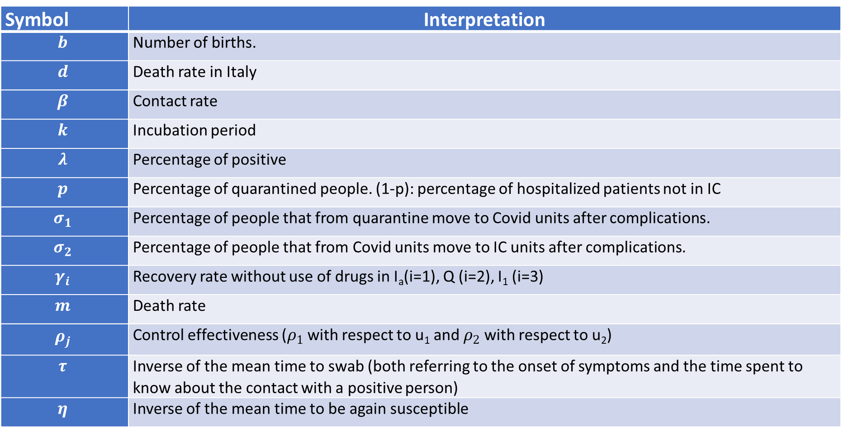
Model: parameters interpretation
Symbol | Interpretation
$$b$$ | Number of births.
$$d$$ | Death rate in Italy
$$β$$ | Contact rate
$$k$$ | Incubation period
$$λ$$ | Percentage of positive
$$p$$ | Percentage of quarantined people. (1-p): percentage of hospitalized patients not in IC
$$σ_{1}$$ | Percentage of people that from quarantine move to Covid units after complications.
$$σ_{2}$$ | Percentage of people that from Covid units move to IC units after complications.
$$γ_{i}$$ | Recovery rate without use of drugs in I_{a}(i=1), Q (i=2), I₁ (i=3)
$$m$$ | Death rate
$$ρ_{j}$$ | Control effectiveness ($ρ_{1}$ with respect to u₁ and $ρ_{2}$ with respect to u₂)
$$τ$$ | Inverse of the mean time to swab (both referring to the onset of symptoms and the time spent to know about the contact with a positive person)
$$η$$ | Inverse of the mean time to be again susceptible

Slide 5
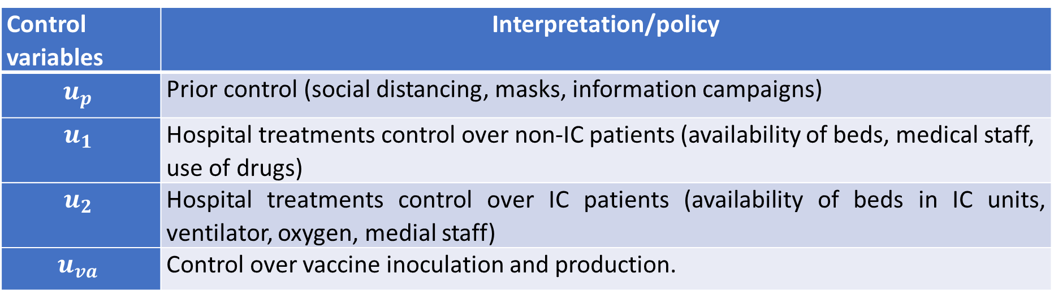
Model: control actions interpretation
We consider four different way to control the system:
Control variables | Interpretation/policy
$$u_{p}$$ | Prior control (social distancing, masks, information campaigns)
$$u_{1}$$ | Hospital treatments control over non-IC patients (availability of beds, medical staff, use of drugs)
$$u_{2}$$ | Hospital treatments control over IC patients (availability of beds in IC units, ventilator, oxygen, medial staff)
$$u_{va}$$ | Control over vaccine inoculation and production.
With $u_{p}∈\left[0,1\right],u_{1}∈\left[0,1\right],$ $u_{2}∈\left[0,1\right],$ $u_{va}∈\left[0,1\right]$

Slide 6



















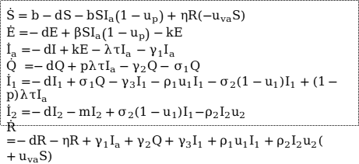

Block diagram
$$b$$
$$S$$
$$βI_{a}\left(1−u_{p}\right)$$
$$E$$
$$k$$
$$I_{a}$$
$$η$$
$$pλτ$$
$$(1−p)λτ$$
Each block has an implicit ougoing flow representing the death d
$$u_{va}$$
$$Q$$
$$σ_{1}$$
$$I_{1}$$
$$σ_{2}(1−u_{1})$$
$$I_{2}$$
$$m$$
$$γ_{3}+ρ_{1}u_{1}$$
$$γ_{2}$$
$$ρ_{2}u_{2}$$
$$\dot{S}=b−dS−bSI_{a}\left(1−u_{p}\right)+ηR(−u_{va}S)$$
$$\dot{E}=−dE+βSI_{a}\left(1−u_{p}\right)−kE$$
${\dot{I}}_{a}=−dI+kE−λτI_{a}$ $−γ_{1}I_{a}$
$\dot{Q} =−dQ+pλτI_{a}−γ_{2}Q−$ $σ_{1}Q$
${\dot{I}}_{1}=−dI_{1}+σ_{1}Q−γ_{3}I_{1}−ρ_{1}u_{1}I_{1}−σ_{2}\left(1−u_{1}\right)I_{1}+(1−p)λτI_{a}$
$${\dot{I}}_{2}=−dI_{2}−mI_{2}+σ_{2}(1−u_{1})I_{1}{−ρ}_{2}I_{2}u_{2}$$
$$\dot{R}=−dR−ηR+γ_{1}I_{a}+γ_{2}Q+γ_{3}I_{1}+ρ_{1}u_{1}I_{1}+ρ_{2}I_{2}u_{2}(+u_{va}S)$$
$$R$$
$$γ_{1}$$
$$V$$

Slide 7
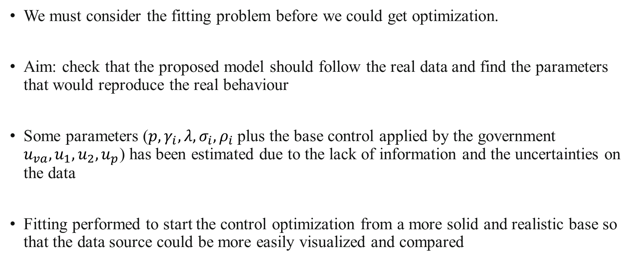
Model fitting
We must consider the fitting problem before we could get optimization.
Aim: check that the proposed model should follow the real data and find the parameters that would reproduce the real behaviour
Some parameters ($p,γ_{i},λ,σ_{i},ρ_{i}$ plus the base control applied by the government $u_{va},u_{1},u_{2},u_{p}$) has been estimated due to the lack of information and the uncertainties on the data
Fitting performed to start the control optimization from a more solid and realistic base so that the data source could be more easily visualized and compared

Slide 8
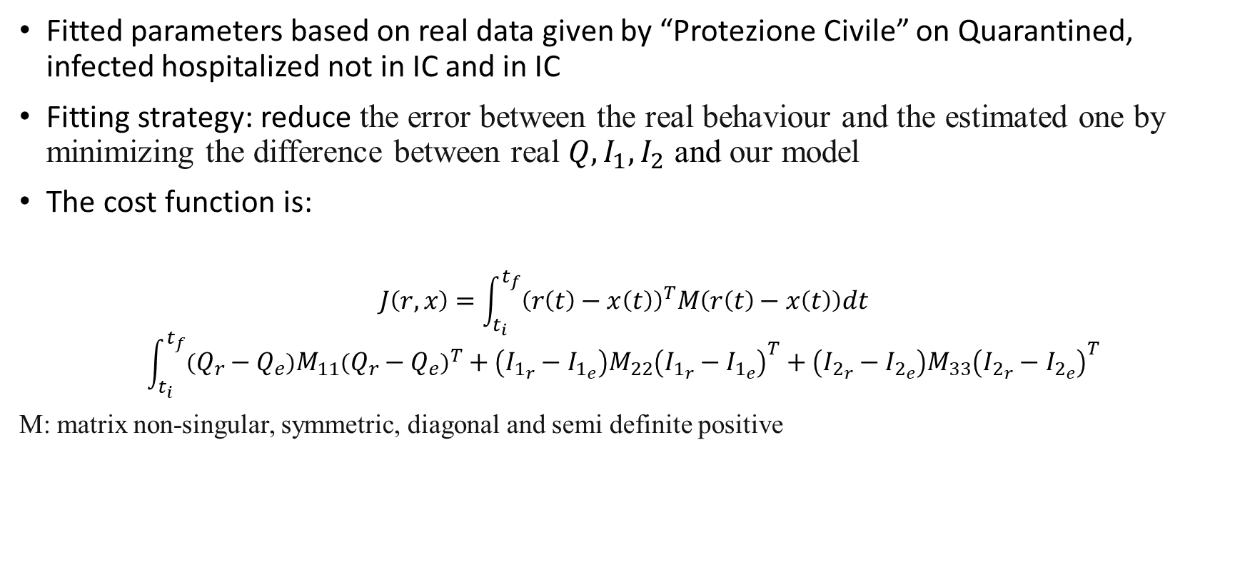
Fitting strategy and objective function definition
Fitted parameters based on real data given by “Protezione Civile” on Quarantined, infected hospitalized not in IC and in IC
Fitting strategy: reduce the error between the real behaviour and the estimated one by minimizing the difference between real $Q,I_{1},I_{2}$ and our model
The cost function is:
$$J\left(r,x\right)=\int_{t_{i}}^{t_{f}}{{\left(r\left(t\right)−x\left(t\right)\right)}^{T}M\left(r\left(t\right)−x\left(t\right)\right)dt}$$
$$\int_{t_{i}}^{t_{f}}{\left(Q_{r}−Q_{e}\right){M_{11}\left(Q_{r}−Q_{e}\right)}^{T}+\left(I_{1_{r}}−I_{1_{e}}\right)M_{22}{\left(I_{1_{r}}−I_{1_{e}}\right)}^{T}+\left(I_{2_{r}}−I_{2_{e}}\right)M_{33}{\left(I_{2_{r}}−I_{2_{e}}\right)}^{T}}$$
M: matrix non-singular, symmetric, diagonal and semi definite positive

Slide 9
Optimal control: motivations and strategies
Find a way to avoid the spread of the virus
Prevent hospitals overcrowding and beds collapse in IC-u avoiding number of deaths
Try to find the best strategy that accomplish the task
Four strategies proposed:
Maximise the number of susceptible (S)
Minimise hospitalised patients in IC (I₂) and hospitalised ones with symptoms not in IC (I₁)
Maximise susceptible (S) and minimise hospitalised patients in IC (I₂) and hospitalised ones with symptoms not in IC (I₁)
Maximise the number of vaccinated subjects (V)

Slide 10

Cost functinos
Each one of the four strategies described above corresponds to a different cost functinon:
1st strategy: $J_{1}\left(S, u\right)=\int_{0}^{t_{f}}{{−α}_{1}S+{\frac{1}{2}u}^{T}βu}$
2nd strategy: $J_{2}\left(I_{1},I_{2},u\right)=\int_{0}^{t_{f}}{γ_{1}I_{1}+γ_{2}I_{2}+{\frac{1}{2}u}^{T}βu}$
3rd strategy: $J_{3}\left(S,I_{1},I_{2},u\right)=\int_{0}^{t_{f}}{{−α}_{2}S+γ_{3}I_{1}+γ_{4}I_{2}+{\frac{1}{2}u}^{T}βu}$
4th strategy: $J_{4}\left(V,u\right)=\int_{0}^{t_{f}}{ζV+\frac{1}{2}u^{T}βu}$
With $α_{i},β,γ_{j},ζ>0 i=1,2;j=1,2,3,4$

Slide 11
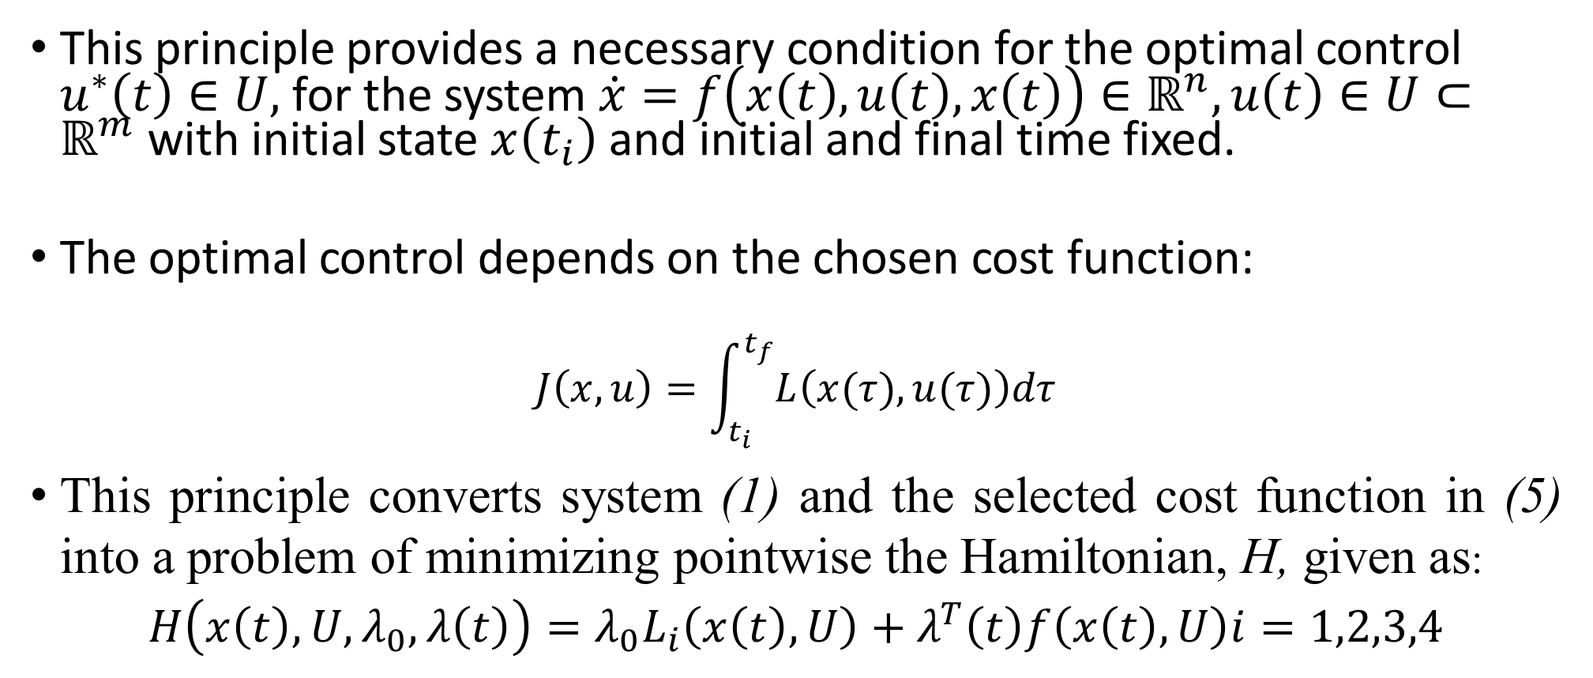
Optimal control problem and solutions: Pontryagin maximum principle
This principle provides a necessary condition for the optimal control $u^{∗}\left(t\right)∈U,$for the system $\dot{x}=f\left(x\left(t\right), u\left(t\right),x\left(t\right)\right)∈ℝ^{n}, u\left(t\right)∈U⊂ℝ^{m}$ with initial state $x\left(t_{i}\right)$and initial and final time fixed.
The optimal control depends on the chosen cost function:
$$J\left(x,u\right)=\int_{t_{i}}^{t_{f}}{L\left(x(τ),u(τ)\right)dτ}$$
This principle converts system (1) and the selected cost function in (5) into a problem of minimizing pointwise the Hamiltonian, H, given as:
$$H\left(x\left(t\right),U,λ_{0},λ\left(t\right)\right)=λ_{0}L_{i}\left(x\left(t\right),U\right)+λ^{T}\left(t\right)f\left(x\left(t\right),U\right)i=1,2,3,4$$

Slide 12
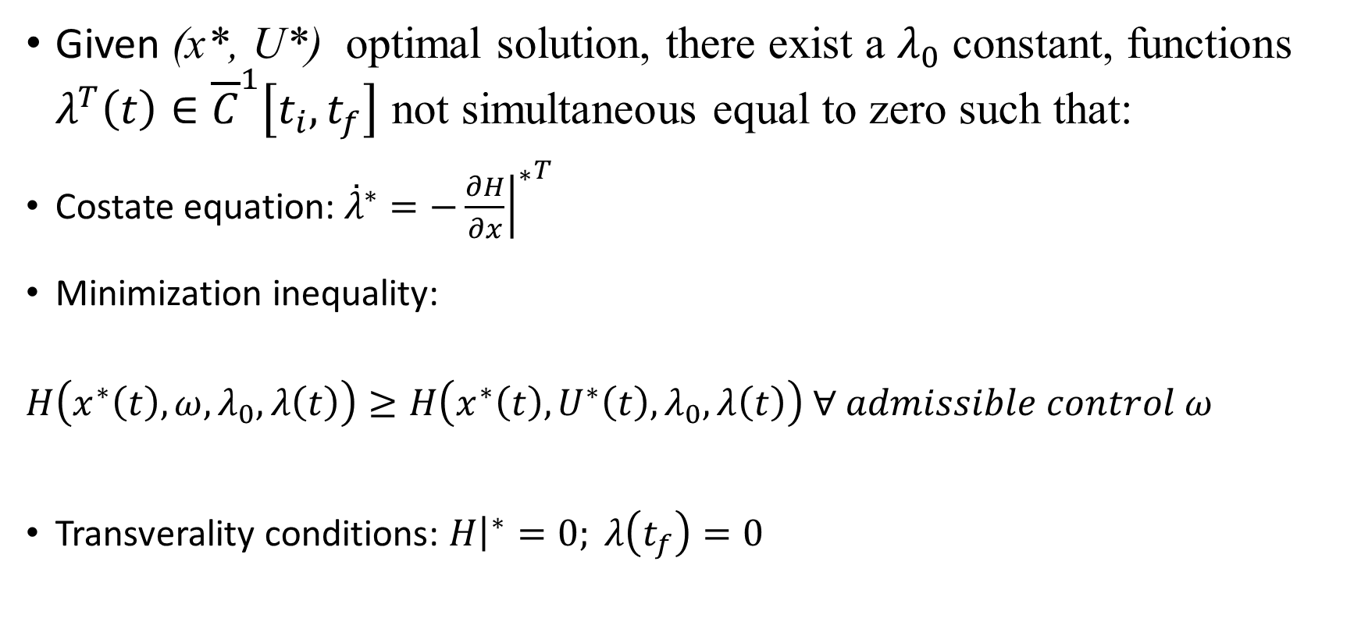
Pontryagin maximum princple: theorem
Given (x*, U*) optimal solution, there exist a $λ_{0}$ constant, functions $λ^{T}\left(t\right)∈{\overline{C}}^{1}\left[t_{i},t_{f}\right]$ not simultaneous equal to zero such that:
Costate equation: ${\overset{˙}{λ}}^{∗}=−{{\left.\frac{∂H}{∂x}\right|}^{∗}}^{T}$
Minimization inequality:
$H\left(x^{∗}\left(t\right),ω,λ_{0},λ\left(t\right)\right)≥H\left(x^{∗}\left(t\right),U^{∗}\left(t\right),λ_{0},λ\left(t\right)\right) ∀ admissible control ω$
Transverality conditions: ${\left.H\right|}^{∗}=0; λ\left(t_{f}\right)=0$

Slide 13
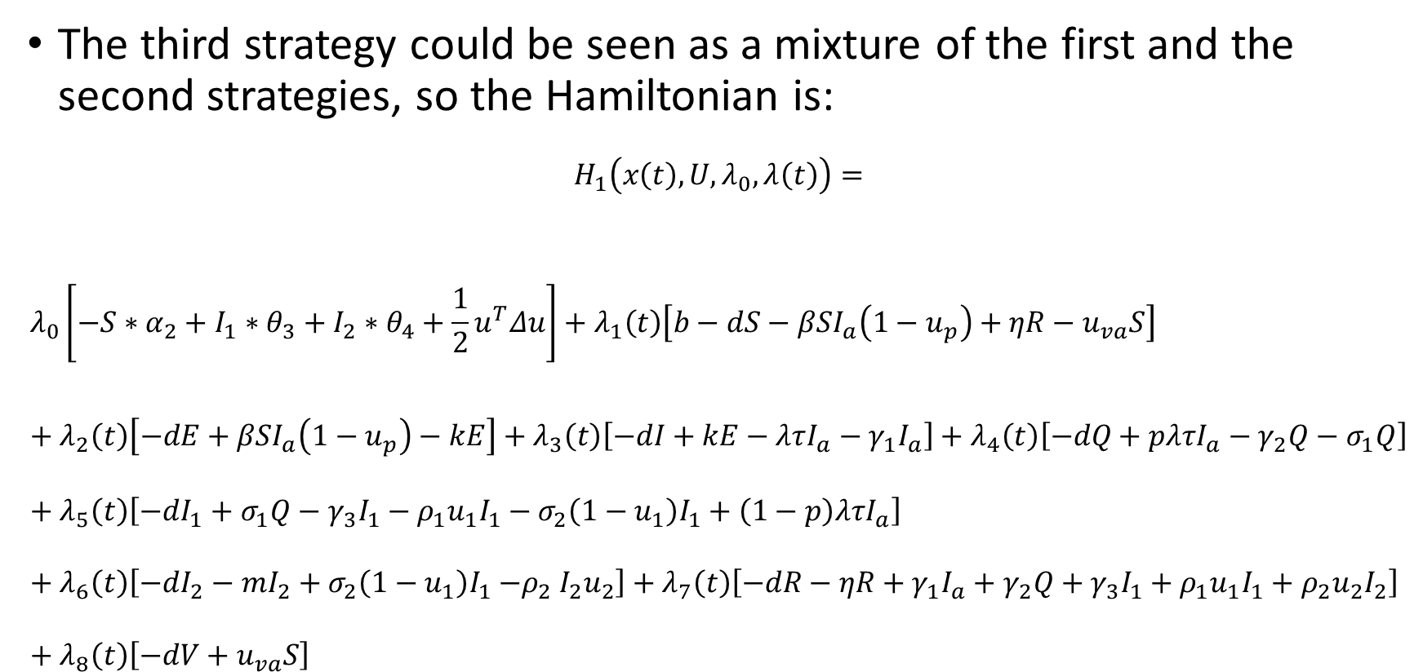
Application of the principle to the strategies
The third strategy could be seen as a mixture of the first and the second strategies, so the Hamiltonian is:
$$H_{1}\left(x\left(t\right),U,λ_{0},λ\left(t\right)\right)=$$
$$λ_{0}\left[−S∗α_{2}+I_{1}∗θ_{3}+I_{2}∗θ_{4}+{\frac{1}{2}u}^{T}Δu\right]+λ_{1}\left(t\right)\left[b−dS−βSI_{a}\left(1−u_{p}\right)+ηR−u_{va}S\right]+λ_{2}\left(t\right)\left[−dE+βSI_{a}\left(1−u_{p}\right)−kE\right]+λ_{3}\left(t\right)\left[−dI+kE−λτI_{a}−γ_{1}I_{a}\right]+λ_{4}\left(t\right)\left[−dQ+pλτI_{a}−γ_{2}Q−σ_{1}Q\right]+λ_{5}\left(t\right)\left[−dI_{1}+σ_{1}Q−γ_{3}I_{1}−ρ_{1}u_{1}I_{1}−σ_{2}\left(1−u_{1}\right)I_{1}+\left(1−p\right)λτI_{a}\right]+λ_{6}\left(t\right)\left[−dI_{2}−mI_{2}+σ_{2}\left(1−u_{1}\right)I_{1}{−ρ}_{2}I_{2}u_{2}\right]+λ_{7}\left(t\right)\left[−dR−ηR+γ_{1}I_{a}+γ_{2}Q+γ_{3}I_{1}+ρ_{1}u_{1}I_{1}+ρ_{2}u_{2}I_{2}\right]+λ_{8}\left(t\right)\left[−dV+u_{va}S\right]$$

Slide 14
Risultati fitting

Slide 15
Risultati/simulazione: Prima strategia
Funzione di costo, risultati (simulazione) e interpretazione/commento

Slide 16
Risultati/simulazione: seconda strategia
Funzione di costo, risultati (simulazione) e interpretazione/commento

Slide 17
Risultati/simulazione: terza strategia
Funzione di costo, risultati (simulazione) e interpretazione/commento

Slide 18
Risultati/simulazione: quarta strategia
Funzione di costo, risultati (simulazione) e interpretazione/commento

Slide 19
Comparazione strategie e commenti sullo sforzo del controllo

Slide 20
Conclusioni

